Slide 1

HOSTEL
The escape room

Slide 2
INDEX
INTRODUCTION & OBJECTIVES
GAME PLAY
GAME DEVELOPMENT
IMPROVEMENTS
QUESTIONS
LET’S PLAY

Slide 3

INTRODUCTION
Promotional Games increase Consumer Conversion Rates and Spending
Word of Mouth:
  THERE’S NO SUCH THING AS BAD PUBLICITY
  NO PUBLICITY IS BAD PUBLICITY
OBJECTIVES
Announce film
Promote the new film
Top 5 highest grossing films
Increase Revenue of past films
INTRODUCTION & OBJECTIVES
GAME PLAY
GAME DEVELOPMENT
IMPROVEMENTS
QUESTIONS
LET’S PLAY

Slide 4

GAME PLAY
Synopsis:
You wake up disorientad in a room, you’re dizzy and confused. It seems you’ve been taken hostage, you don’t remeber what happend or how you got there.You hear some noises and someone leaving. You have to get out of there before they come back.
Objective
Go trough the rooms, check the items and find your way out, before your captors come back
INTRODUCTION & OBJECTIVES
GAME PLAY
GAME DEVELOPMENT
IMPROVEMENTS
QUESTIONS
LET’S PLAY
Notes:
Al ser un juego de lectura conseguimos suspense con: sonidos y espacios

Slide 5
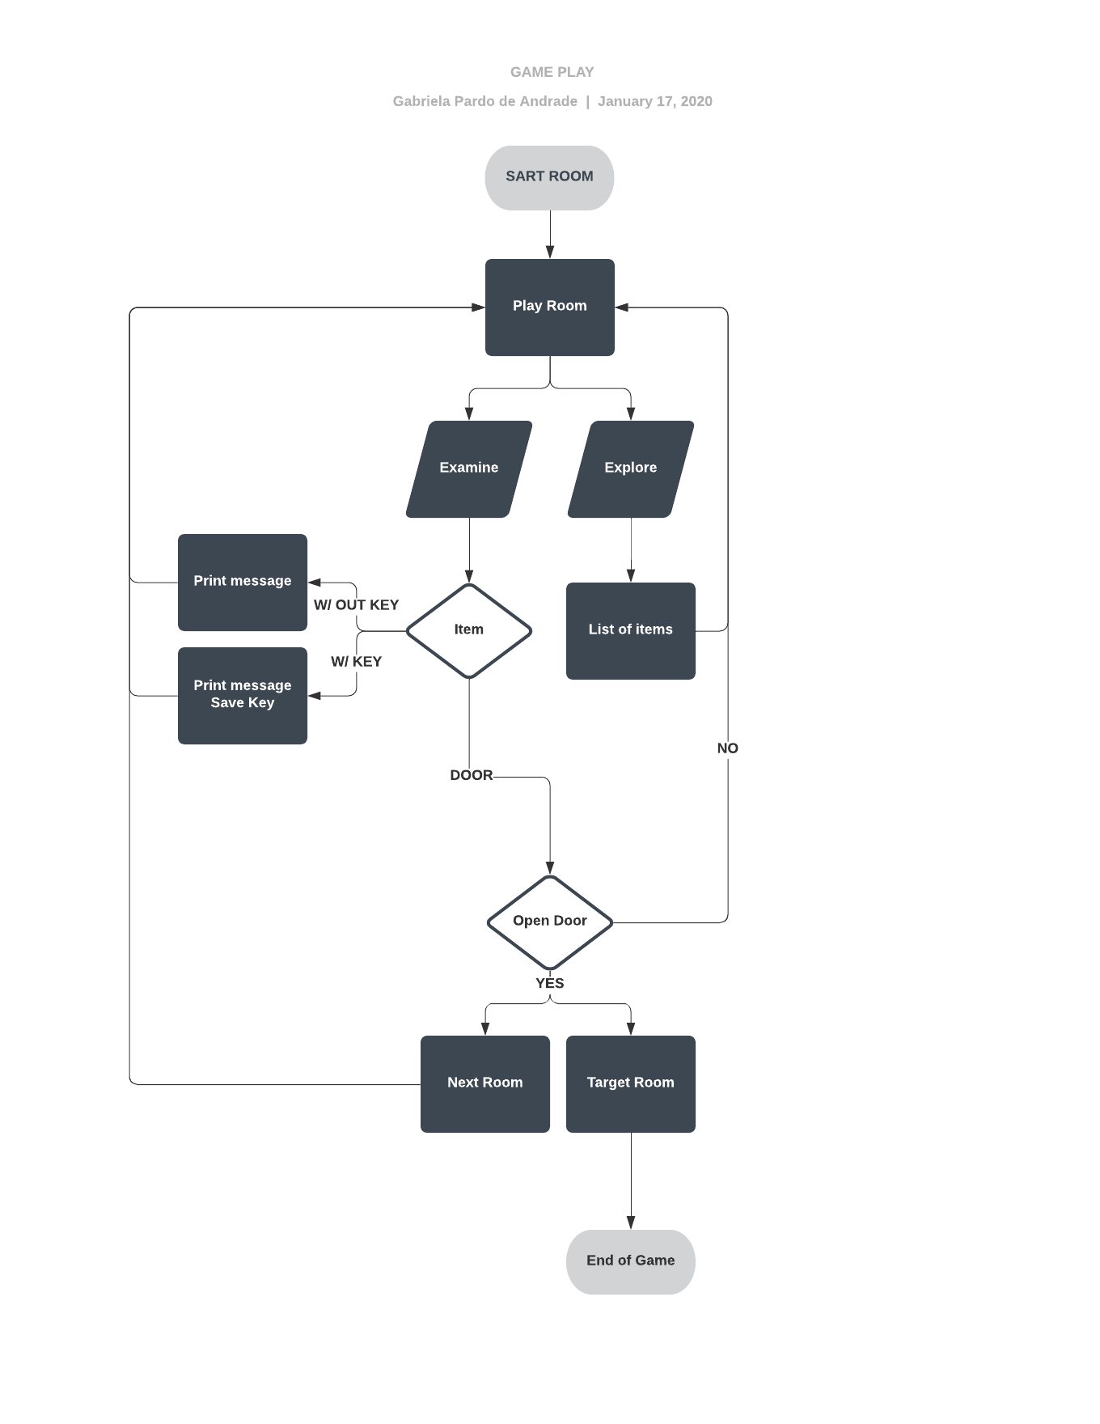
GAME DEVELOPMENT
HOW it works:
Text based Input cycle system, which means that that player will only have to type in what the screen askes for them to do an “action”.
Beta versión is a líneal game with one path.
INTRODUCTION & OBJECTIVES
GAME PLAY
GAME DEVELOPMENT
IMPROVEMENTS
QUESTIONS
LET’S PLAY

Slide 6
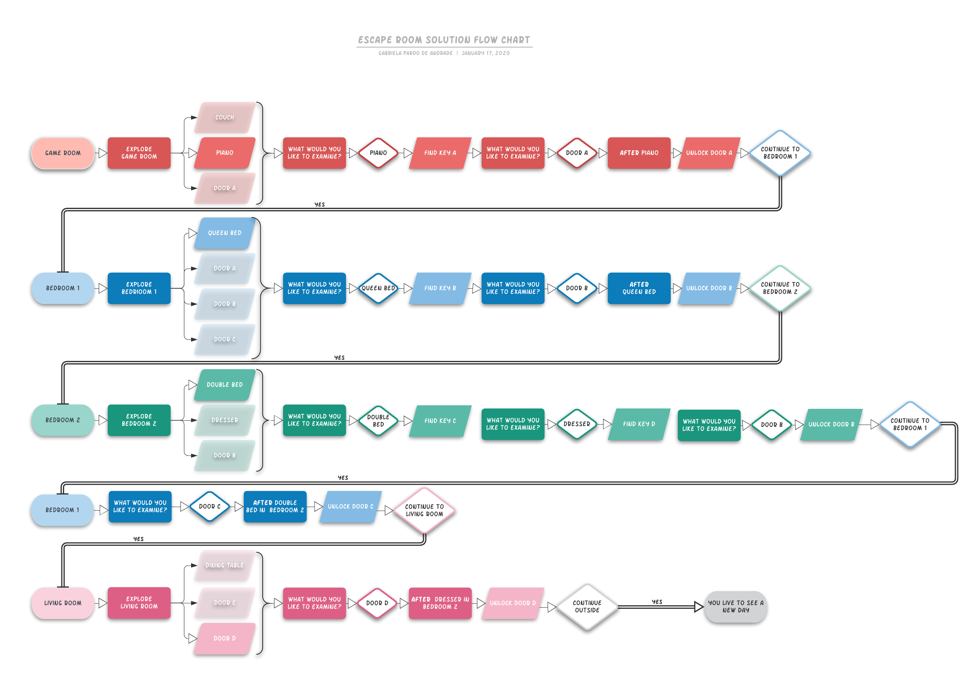
GAME DEVELOPMENT
WHY it works:
The way the game code has been created makes it easy to add locations and items to expand the game. With this type of base code little modifications will have to be done for future expansion or other promotional games.
INTRODUCTION & OBJECTIVES
GAME PLAY
GAME DEVELOPMENT
IMPROVEMENTS
QUESTIONS
LET’S PLAY
Notes:
Juego líneal

Slide 7
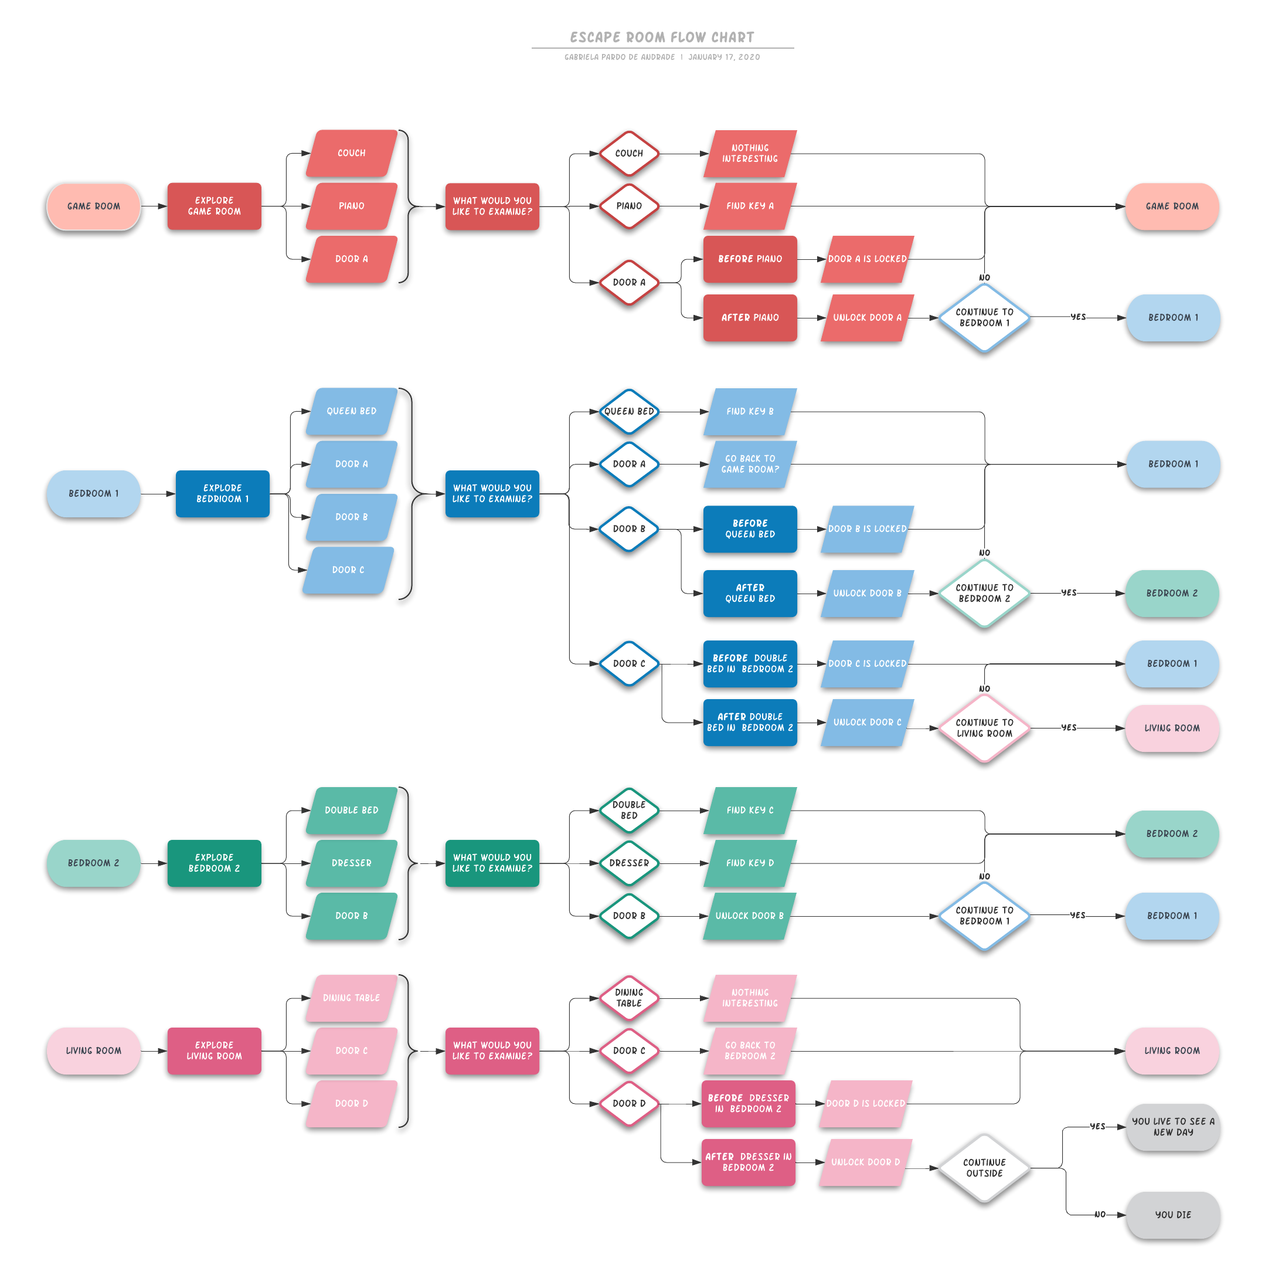
GAME DEVELOPMENT
INTRODUCTION & OBJECTIVES
GAME PLAY
GAME DEVELOPMENT
IMPROVEMENTS
QUESTIONS
LET’S PLAY
Notes:
Flow chart con los elementos base
No introducido nuevos elementos, ni el easter egg

Slide 8




FUTURE IMPROVEMENTS
SHORT TERM
LONG TERM
Game expansion:
  Locations
  Items
  Keys
  Puzzels
  More Easter Eggs
After first release:
  Footage and images.
  Movie Soundtrak
  More revealing stroyline
Interactive game:
  Not text based
  Clicking system
Code Modification
  Location based system
  vs action based system
INTRODUCTION & OBJECTIVES
GAME PLAY
GAME DEVELOPMENT
IMPROVEMENTS
QUESTIONS
LET’S PLAY

Slide 9

INTRODUCTION & OBJECTIVES
GAME PLAY
GAME DEVELOPMENT
IMPROVEMENTS
QUESTIONS
LET’S PLAY

Slide 10

LET’S PLAY
INTRODUCTION & OBJECTIVES
GAME PLAY
GAME DEVELOPMENT
IMPROVEMENTS
QUESTIONS
LET’S PLAY

